Slide 1




NEXT GEN EMPLOYABILITY PROGRAM
Creating a future-ready workforce
Team Members
College Name
Student Name :SWATHI U
Student ID : 511321104099
Kingston Engineering College

Slide 2

CAPSTONE PROJECT SHOWCASE
Project Title
Building Bus Reservation System using Python and Django
Abstract | Problem Statement | Project Overview | Proposed Solution | Technology Used | Modelling & Results | Conclusion

Slide 3
Abstract
In today's fast-paced world, efficient transportation systems are crucial for facilitating smooth mobility. One key aspect of transportation is bus reservation systems, which allow passengers to book seats conveniently and operators to manage their fleets effectively. This project aims to develop a Bus Reservation System using Python and Django framework, providing a user-friendly interface for both passengers and administrators.
The system will offer various features including:
1.User Registration and Authentication
2.Bus Route Management
3.Ticket Management
4.Payment Integration
5.Email Notifications
Source :

Slide 4
Problem Statement
In today's urban landscape, efficient transportation systems are vital for ensuring smooth mobility and connectivity. However, the existing bus reservation systems often lack user-friendly interfaces and robust functionalities, leading to inconvenience for both passengers and administrators. Hence, there is a pressing need to develop a comprehensive Bus Reservation System that addresses these shortcomings while leveraging the capabilities of modern technologies.
User Convenience:
Develop a user-friendly interface that allows passengers to easily search for available buses, select seats, and make reservations online. The system should offer seamless navigation and intuitive controls to enhance the booking experience.
Efficient Bus Management:
Create an administrative interface for managing bus routes, schedules, seat availability, and ticketing. Administrators should have the ability to add, edit, or remove routes, as well as monitor reservation statuses and generate reports.
Source :

Slide 5
Project Overview
Introduction:
The Bus Reservation System project aims to develop a comprehensive web-based platform using Python and Django framework to facilitate easy and efficient booking of bus tickets. The system will provide a user-friendly interface for passengers to search for available buses, select seats, and make reservations online. Additionally, it will offer administrative tools for managing bus routes, schedules, and ticketing, thus streamlining the overall bus operations.
Key Features:
User Registration and Authentication
Bus Route Management
Seat Reservation
Ticket Management
Admin Dashboard
Source :

Slide 6
Proposed Solution
.
Introduction:
The proposed solution involves developing a robust and user-friendly Bus Reservation System using Python and the Django framework. This system will streamline the process of booking bus tickets for passengers while providing efficient management tools for administrators to oversee bus operations effectively.
Key Components and Features:
User Authentication and Registration
Bus Route Management
Seat Reservation
Ticket Management
Payment Integration
Source :

Slide 7
Implementation Plan:
1.Requirement Gathering and Analysis:
Conduct thorough research to understand the needs of passengers and bus operators, identifying key features and functionalities required for the system.
2.System Design:
Design the system architecture, database schema, and user interface layout based on the gathered requirements.
3.Backend Development:
Implement backend functionalities using Python and Django, including user authentication, bus route management, seat reservation logic, and payment integration.
4.Frontend Development:
Develop the user interface using HTML, CSS, and JavaScript, ensuring a seamless and intuitive booking experience for passengers.
5.Testing and Quality Assurance: Conduct extensive testing to ensure the system's reliability, security, and performance under various scenarios.
Source :

Slide 8
6.Deployment:
Deploy the Bus Reservation System on a suitable web hosting platform, configure servers, and set up necessary databases and security measures.
7.Maintenance and Support:
Provide ongoing maintenance and support to address any issues, implement updates, and enhance system functionalities as needed.
Conclusion:
The proposed Bus Reservation System will offer a comprehensive solution for passengers to book bus tickets conveniently while providing administrators with powerful tools to manage bus operations efficiently. By leveraging the capabilities of Python and Django, the system will be scalable, secure, and user-friendly, catering to the evolving needs of the transportation industry.
Source :

Slide 9

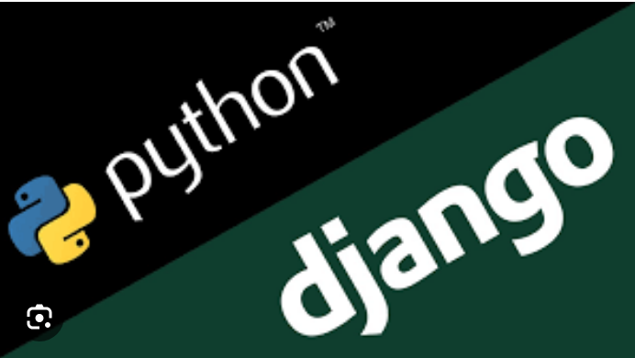
Technology Used
Front-end
Back-end
Source :

Slide 10
Modelling & Results
1.Database Model Design:
•Utilize Django's ORM to define models for buses, routes, schedules, seats, bookings, and users.
2.User Interface Design:
•Design user-friendly interfaces using HTML, CSS, and JavaScript with responsiveness to ensure
compatibility across devices.
3.Authentication and Authorization:
•Implement user authentication and registration functionality using Django's built-in authentication
system.
4.Bus Route Management:
-Include form validation to enforce data integrity and prevent invalid inputs.
5.Testing and Validation:
•Conduct unit tests to verify the functionality of individual components and integration tests to ensure
seamless interaction between modules.
Results:
• Improved user experience
• Scalability and flexibility
Source :

Slide 11
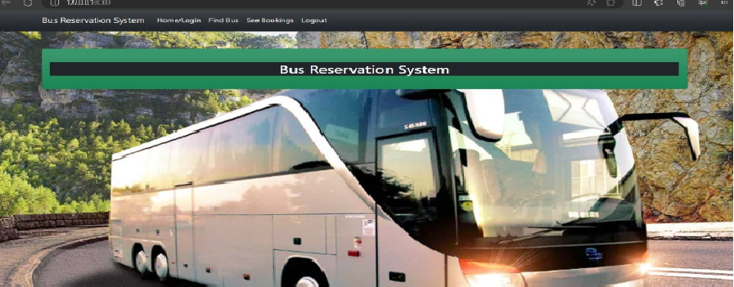
Homepage

Slide 12
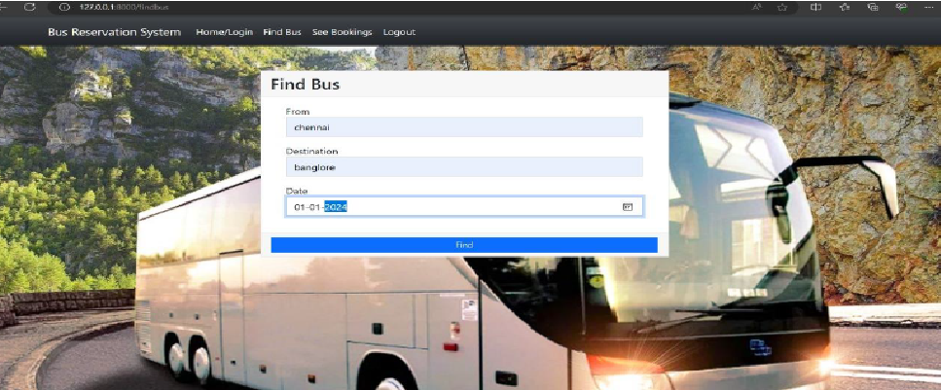
About us page

Slide 13
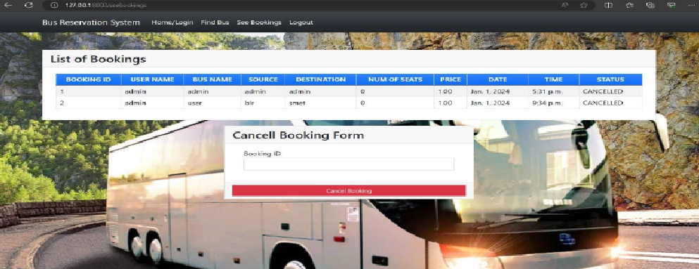
Service-Page

Slide 14
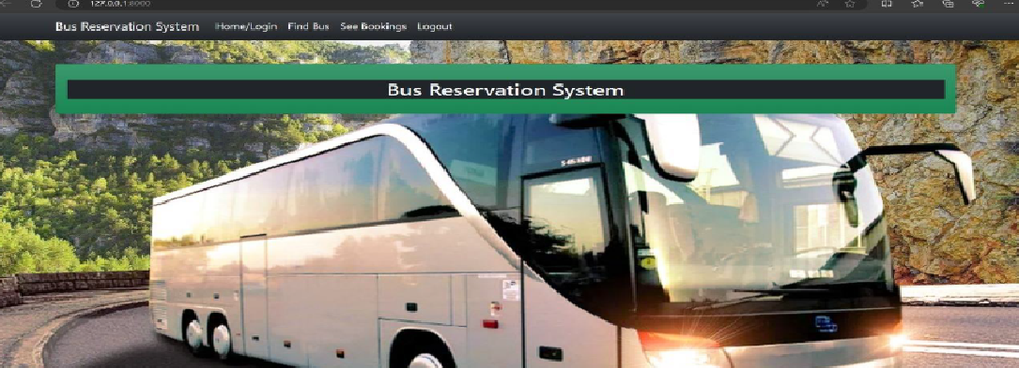
Departments-Page

Slide 15
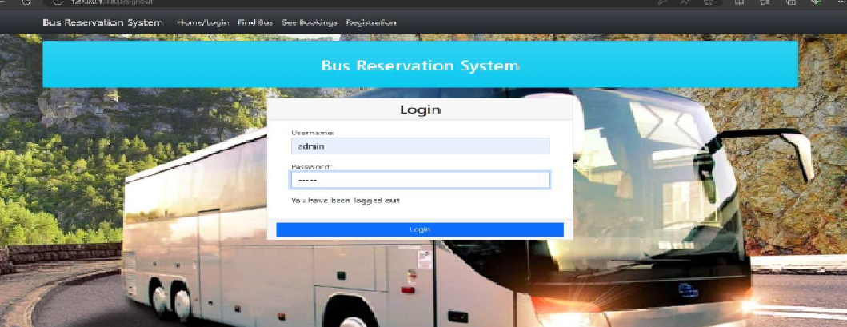
Blog-Page

Slide 16
Future Enhancements:
Mobile Application Development:
Extend the system by developing a mobile application for both Android and iOS platforms. This would provide users with greater accessibility and convenience, allowing them to book tickets on the go.
Advanced Analytics and Reporting:
Enhance the admin dashboard with advanced analytics and reporting features. Provide insights into booking trends, popular routes, peak booking times, and revenue analysis to help administrators make data-driven decisions.
Dynamic Pricing and Offers:
Implement dynamic pricing algorithms based on factors such as demand, time of booking, and seat availability. Introduce promotional offers, discounts, and loyalty programs to attract more users and increase customer retention.
Accessibility Features:
Improve accessibility features to cater to users with disabilities. Ensure compatibility with screen readers, provide alternative text for images, and optimize the user interface for keyboard navigation and voice commands.

Slide 17
Conclusion
In conclusion, the development of a Bus Reservation System using Python and Django presents a promising solution to streamline the booking process and enhance the overall efficiency of bus operations. Throughout the project, we have addressed the various challenges and requirements involved in creating a robust and user-friendly platform for both passengers and administrators.
Furthermore, the proposed future enhancements such as mobile application development, advanced analytics, and integration with public transport networks demonstrate our commitment to continuous improvement and innovation. These enhancements aim to further enhance user experience, expand the system's capabilities, and stay ahead of emerging trends in the transportation industry.
Overall, the Bus Reservation System serves as a testament to the capabilities of Python and Django in building sophisticated web applications that meet the evolving needs of modern businesses.
Source :

Slide 18
Thank You!
Notes:
Thank You !!

